Slide 1
How to Combat Corruption
Course by Digni and Wycliffe.
Grassroots anti-corruption course version 3/2016

Slide 2
Case Study
Peter had practiced his driving skills with his instructor for months. It was now days before his test, and he felt he was ready for it. He stopped the car and waited for final feedback from his teacher.
What came next was not what he had expected. The driving instructor told him that if he wanted to pass his test, he would need to bribe the examiner. If Peter would give 100 dollars to the instructor, he would happily act as go-between, making sure the examiner received his money before the test began.
What do you think of this situation?
What would you do?

Slide 3
Course Background
Need for a grassroots course
Pragmatic approach

Slide 4
Contents
Part 1: Awareness raising
Part 2: Preventing corruption
Part 3: How can ordinary people fight corruption?
Part 4: Developing and implementing policies & procedures

Slide 5
A Note on Terms
This course use the term “organisation”. With an organisation we mean a NGO, business/company, a school, a religious organisation etc. It should be seen as very broad.

Slide 6
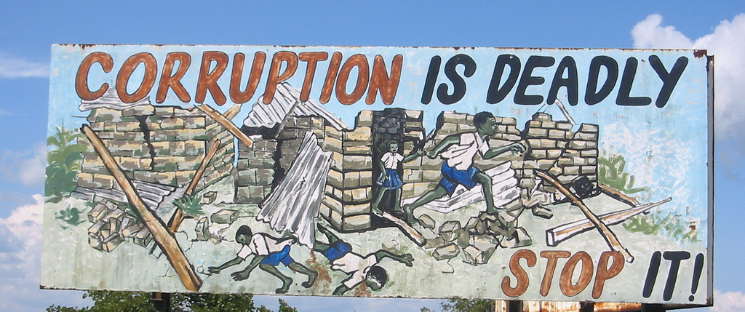
Part 1: Awareness Raising

Slide 7
Introduction: What is Corruption?
What we’ll look at in Part 1:
What is corruption?
Why is corruption so dangerous?
What does corruption look like?
Where can corruption be found?
How does corruption start?
Notes:
Bilde? Noe mer?

Slide 8
Case Study
A non-profit organisation is going to purchase a new office building. As a result, the present office building is sold for USD 250,000. According to government tax regulations, the buyer must pay taxes based on the selling price. As this is a large percentage, the organisation makes a deal with the buyer to “reduce” the nominal selling price to USD 150,000 on a separate invoice, so that the buyer will pay a much lower tax.
Questions:
If you were a board member of this non-profit organisation:
What would you think about this?
How would you respond?

Slide 9
Case Study
Your daughter was hit by a car and rushed to the nearest hospital. You pay a lot of money for surgery, treatment, medication and a hospital room. The seriousness of her injuries requires that she stay in hospital for at least a week. Despite having already paid for her care, your daughter complains that the nurses don’t help her when asked. You know that if you give the nurse a few extra dollars a day she will take care of your daughter.
Questions:
How do you feel about this situation?
Would it be wrong to pay the nurses extra?
What could you do in this situation?
What would you do in this situation?

Slide 10
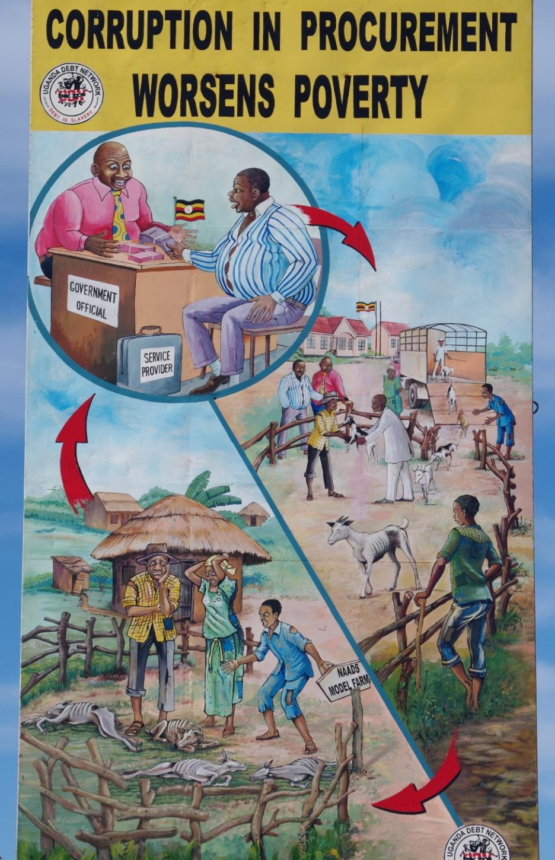
Stories
In what ways have you experienced or heard about corruption?
Personal examples
Second-hand examples
Experiences with the government, religious organisations, NGOs and international organisations
In businesses or with other organisations

Slide 11
What is Corruption?
Group Activity
Define and describe corruption in one sentence.

Slide 12
What is Corruption?
Sample definitions of corruption:
The abuse of power for private and personal advantage.
To get or take advantage by means which are illegitimate, immoral and/or inconsistent with one’s duty or the rights of others.
The word corrupt means "utterly broken". The word was first used by Aristotle and later by Cicero who added the terms “bribe and abandonment of good habits”.

Slide 13
Why is corruption harmful?

Slide 14
Why is Corruption Harmful?
is unfair and harms those without power
results in a loss of values and morality
results in financial loss
results in loss of trust in government, justice and public services
results in illegal activities, encourages organized crime
creates an inefficient society
creates fear and insecurity
“I believe that corruption kills more people across the globe than terrorism”
- Robert Lugolobi, Executive Director of Transparency International

Slide 15
Case Study
One day you are riding your motorcycle and a police car stops you on the motorway because you are not wearing your helmet. (The law in your country is that everyone who drives a motorcycle must wear a helmet.)The police officer tells you to pay a fine of 100 USD, but will ignore the violation if you pay him 20 USD.
Questions:
Should you pay the policeman?
Would it make a difference if the policeman only asked for 5 USD?

Slide 16
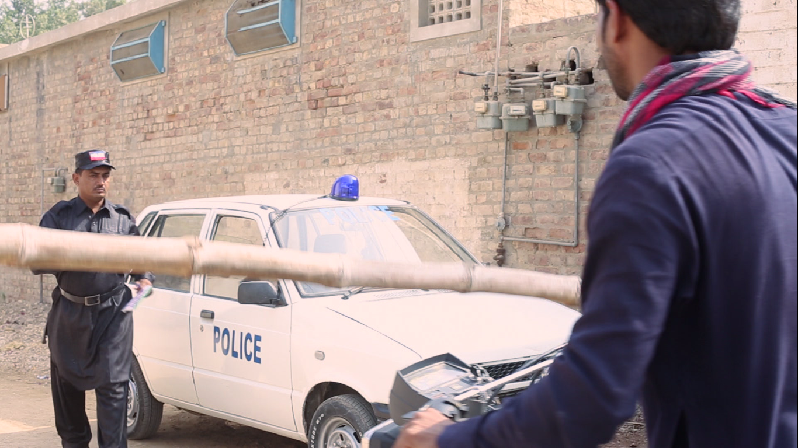
Video
Notes:
The film can be found online here: https://vimeo.com/154570743

Slide 17
Video
Questions:
What do you think of this situation?
What would you do?

Slide 18
Case Study
The project manager invites representatives of different stakeholders to participate in a one day meeting to discuss an application for a second project phase. The meeting is held during work hours, and after the meeting the government representative asks for his/her “sitting allowance” (payment for his/her meeting attendance).
Questions:
Is this acceptable?
The government official asks the project manager not to issue a receipt.
Are there similar practices in your country?
Can this situation be avoided? If so, how?

Slide 19
Levels of Corruption
Grand corruption: takes place at higher levels of government, large companies and NGOs, and involves mismanagement of large amounts of money - for example, diverting funds from a social program for personal use.
Petty corruption: small incidences of corruption, often on a local level, by people like policemen and judges. This type of corruption affects the poor most directly. An example of corruption at the local level is the need to pay bribes to public servants/local officials.

Slide 20
Types of Corruption
Bribery: money or services offered illegally to get something in return
Active: When you offer a bribe
Passive: When you accept or demand a bribe
Kickback: illegal form of commission
Nepotism: favoritism granted to family, relatives or friends
Facilitation payments: asking for money for legally free services
Collusion: secret agreements by at least two parties for illegal gain
Embezzlement: misuse of someone else's money
Abuse of power
Question: Have you been confronted with any of these types?

Slide 21
Where can corruption be found?

Slide 22
Where Can Corruption be Found?
Corruption
Military
Educational
Traditional Authorities
NGOs
Govern-ment
Local Community
Legal System
Customs
Politicians
Political parties
Press
Business community
Consultants
Police
Religious organisations
Health Services
Civil servants
Individuals

Slide 23
Potential Signs of Corruption in an Individual
A lifestyle that is not in line with income
Deliberately working alone, or always with the same colleague
Secretive phone calls
Many discrepancies in the petty cash, round figures
Lots of incorrect or missing invoices, cash tickets etc.
Irritability, suspiciousness or defensiveness
Control issues: unwillingness to share duties
Unusually close association with vendor/customer
Addiction problems
Someone who always arrives first and leaves last

Slide 24
Does What I do Matter?
Good questions to ask yourself:
Do I mind if others, including colleagues and donors, know what I am doing?
Is there a set of standards and a person or people that I am accountable to?
Does the way I work show respect for others?
If everyone copied my actions would it harm others?
In my organisation?
In my community?

Slide 25
Possible Signs of Corruption in an Organisation
Poor, unclear financial administration could hide:
“Double-dipping”- looking for or accepting funds from more than one donor for a project that is already funded
Inflated, duplicate, or fictional invoices for goods and services
Policies and procedures are not present or not respected, these could hide:
Kickbacks : the person in charge of buying or hiring makes deals so that he/she gets part of the money personally.
Extortion of bribes or other benefits (including sexual favours) from beneficiaries.
“Ghost” employees: fictional personnel that inflate project costs.

Slide 26
Possible Signs of Corruption in an Organisation
Complicated legal structure could hide:
Fictitious NGOs, established only to generate income for executives or Board members
One person has all the power; no working control system is in place
Strange or late reporting (such as copy/paste from previous reports, activities not agreed on, no problems) can hide:
Double dipping
The fact that no activities took place
Other problems

Slide 27
Possible Signs of Corruption in an Organisation
Unexpected departure of personnel
Potential reasons
Corruption was found, an employee was dismissed but the case was not reported.
Employee found corruption and decided to leave. No safe whistle blowing procedure.

Slide 28
Case Study
You need to have your identity card processed at a government office. Your relative happens to work at the office, so in order to speed up the process and avoid standing in line, you ask for her help speeding things up. Later you give her 20 USD as a gift.
Questions:
Could you or your relative’s actions be considered illegal?
Did your action hurt others?

Slide 29
Role Play
The general manager of your organisation is approached by a government official. The official offers a large sum of money if the general manager keeps silent about specific cases of discrimination against the minority group with which your organisation works.

Slide 30
What are reasons that a person working for an organisation might get involved in corruption?

Slide 31
Fraud Triangle
In the1950s the criminologist Donald R. Casey developed a theory that is now known as the Fraud Triangle
Let’s see if this triangle can also be applied to corruption … in most cases, it can!

Slide 32
Pressure
A person feels the need to do something corrupt because of pressure.
Pressures can include:
Financial problems
Medical bills
Need for more security, for example, securing a pension
The need for status
Not being paid enough to meet your needs
Family or friends expect help

Slide 33
Systemic Pressure
In some places corruption is a way of life and pressure is almost always present.
YOU
Government
Professional networks
Family
and friends
(HELP!)

Slide 34
Opportunity
Opportunity is the ability to act corruptly without
being caught.
Some issues that can create opportunities include:
Weak internal controls
Poor management oversight
Being in a position of leadership and authority
Inadequate procedures to detect corrupt activities.

Slide 35
Rationalisation
Rationalisation is how an individual or an organisation finds reasons or excuses for acting corruptly.
Some common reasons include:
Everybody does it.
It comes with the job; you deserve it.
It’s not really corruption, but cultural; it’s just the way we do things here.
It’s going to help somebody, so it’s not really so bad.

Slide 36
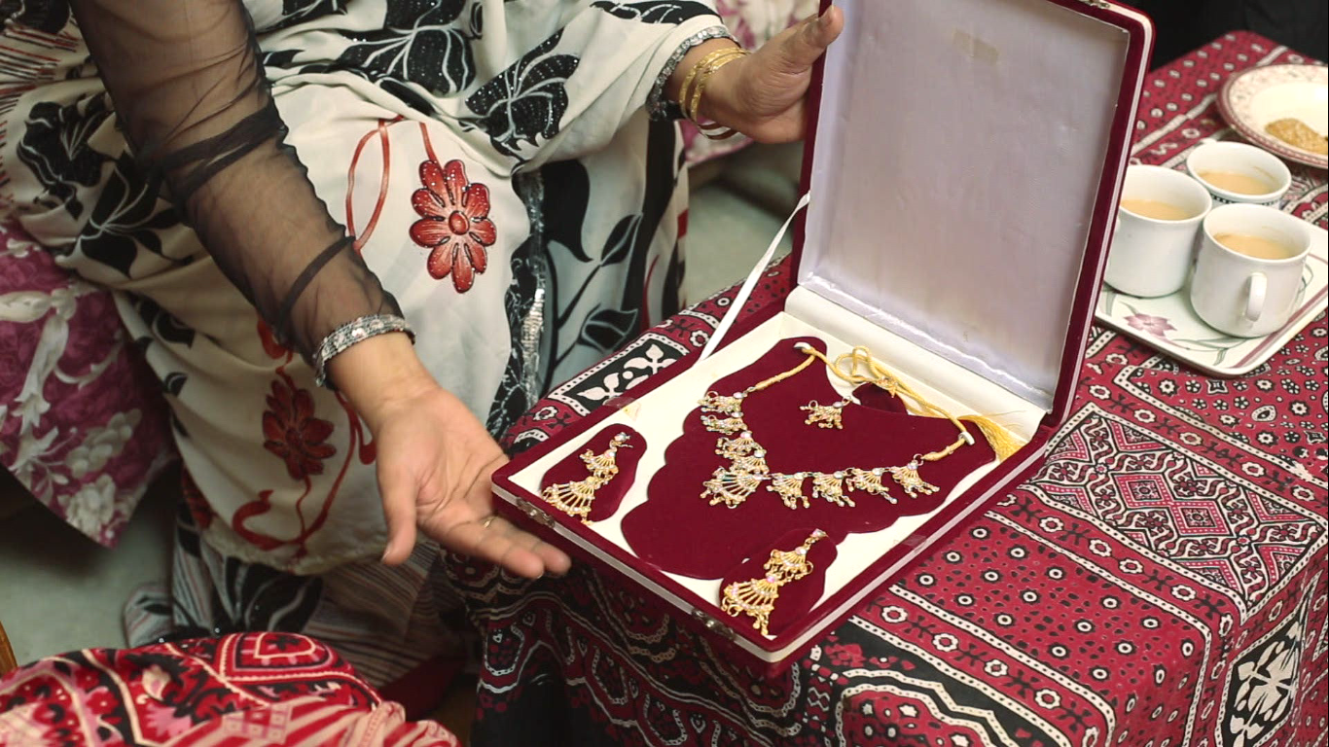
Video
Notes:
The film can be found online here: https://vimeo.com/154576357

Slide 37
Video
What would you do in the teacher’s situation?
Why do you think the teacher acted this way?
What are the possible consequences of corruption in education?

Slide 38
What could be some reasons for an organisation to become involved in corruption?

Slide 39
Roots: Organisation
Corruption in an organisation also comes from pressure, opportunity and rationalization. A few reasons an organisation might use are:
Honesty makes it harder to compete.
An organisation cannot be successful without bribes.
Shareholders expect a high return on their investment.
Government is corrupt, so paying taxes is wasting money
Money for taxes is better spent on good purposes (e.g. helping people, saving lives)
It’s normal and culturally acceptable.
Sometimes organisations get started as a platform for illegal activities.

Slide 40
If my Organisation is Guilty, am I Guilty too?
Not everyone working in a corrupt organisation is corrupt.
At the end of the day, the leadership of an organisation has the most responsibility to keep corruption out.
However, it’s your job to resist corruption as much as you can.

Slide 41
Role Play
The director of an education NGO has made an application to the local government council for a new school building. He is invited to come and see the mayor, because there is good news!

Slide 42
Conclusion Part One: What have we Learned?
A better understanding of corruption is the first step to fight it!
Before we can fight corruption, we must understand some of its roots.

Slide 43
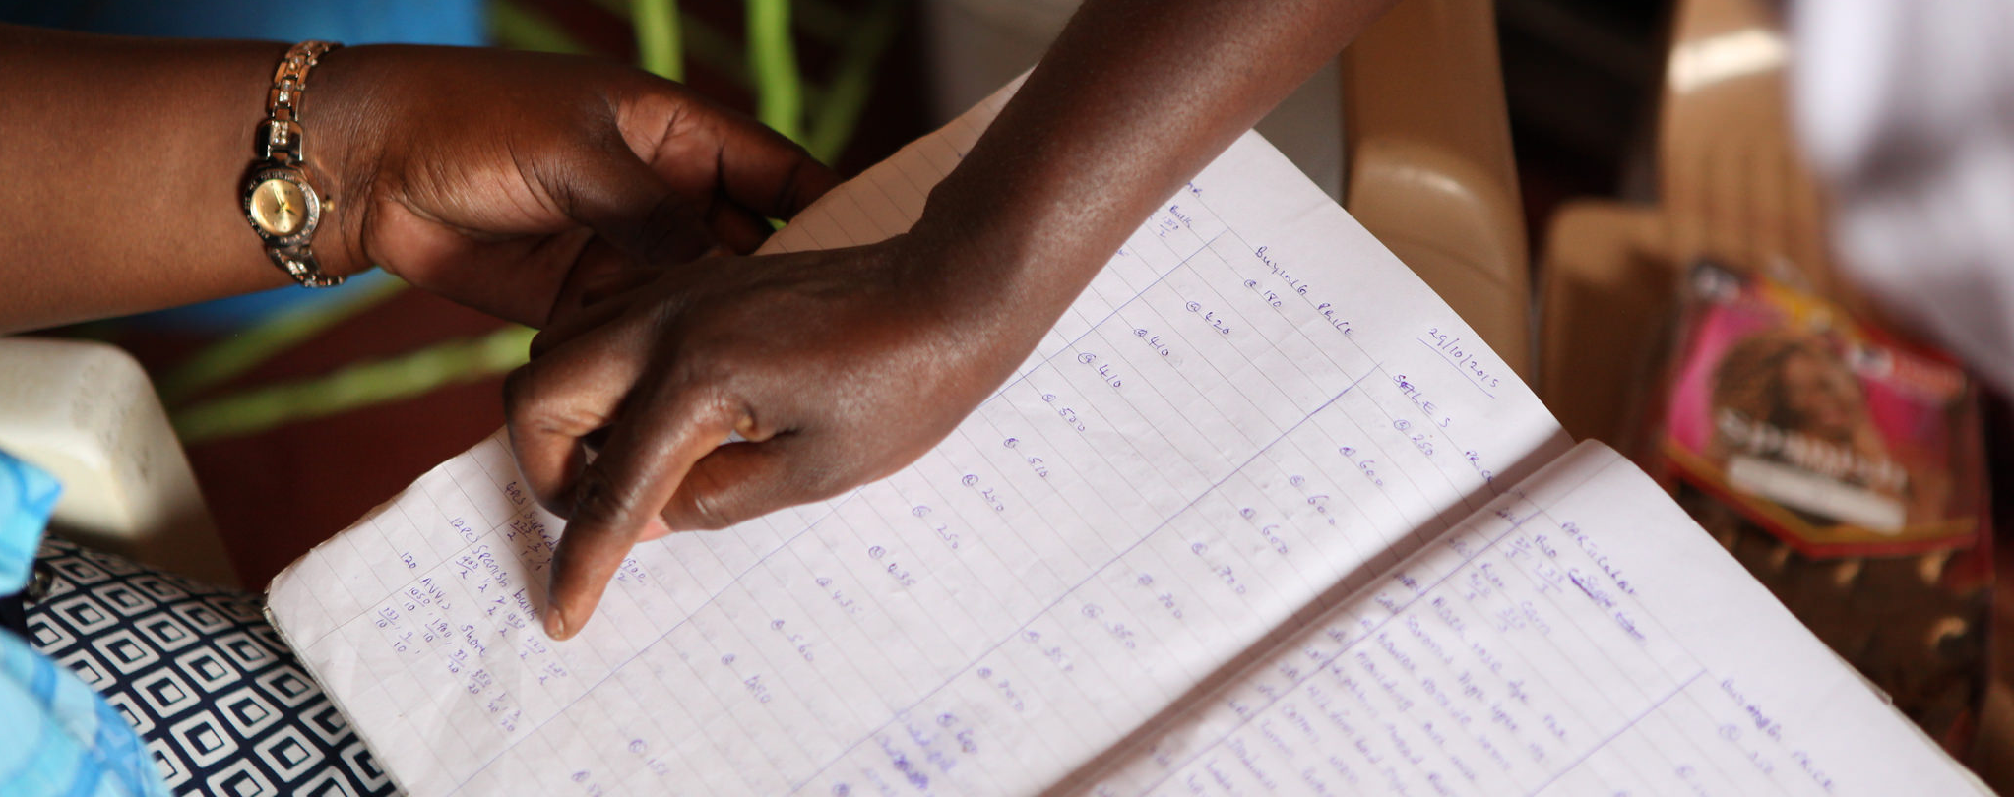
Part 2: Preventing Corruption

Slide 44
What we’ll look at in Part 2
Personal attributes and behaviour that can prevent corruption.
Some positive organisational policies and standards that can prevent corruption.
Good policies and procedures: What are they and why are they important?

Slide 45
What are some personal characteristics that can prevent an individual from becoming corrupt?

Slide 46
Good Personal Attributes & Behaviour
Be honest
Use your power for officially authorized and justified purposes only
Be trustworthy
Be transparent
Abide by the law: respect the rules, regulations, statutes and laws of local and civil authorities
Be accountable to others in the organisation, the board and others in authority

Slide 47
What can an organisation do to prevent corruption from happening?

Slide 48
Positive Organisational Policies
An organisation needs a standard set of policies like:
Code of conduct
Set of rules to prevent corruption
Procedure re. internal monitoring and evaluation
Reporting guidelines and routines
Have a safe procedure in place to report corruption
Sanctions for those who act corruptly
Clear policies & procedures for project asset ownership and transfer

Slide 49
Positive Organisational Standards
Financial Transparency & Good Practice in:
Decision making
Monitoring & Reporting
Accounting
Spending
Proper Human Resources management
Fair compensation/salaries & other employee benefits
Clear and detailed job descriptions
Documented career advancement strategies
Management & Power
Prepared to answer questions, admit mistakes and, where possible, rectify any errors

Slide 50
What are Policies and Procedures?
Policies are clear, simple statements of how your organisation intends to conduct its services, actions or business.
Procedures describe how each policy will be used. Each procedure should outline:
Who is responsible for doing what
What steps need to be taken
Which forms or documents to use

Slide 51
Who Makes and Keeps Policies and Procedures?
Policies and procedures can be written by the management and should be approved by the board of the organisation.
The management of the organisation ensures that the rules are respected. They report to the board, who should follow up on all issues according to national law.

Slide 52
Case Study
All project staff attend a 3 day capacity building conference. The organiser pays for the hotel and three meals a day for all participants. At the end of the three days, the project manager starts paying allowance covering accommodation, food and transport to all the project employees. One of the employees says that the allowance should be reduced since accommodation and food was free. He is told by the others to keep silent. The project manager says that full allowance should be paid out because no one will ever find out. The project manager is clearly trying to stay on good terms with his employees.
Questions:
What is wrong here?
What are some possible negative consequences?

Slide 53
Role Play
The context: The boss calls one of the employees into his/her office to reprimand him/her…

Slide 54
Case Study
You are the managing director of an NGO and you receive a subsidy for building a community center in one of the villages you work in. This is a big project and the budget is considerable. Your nephew happens to run a construction company and he makes it very clear that he expects you to give him the job because you are family. You realise that if you decide not to give him the job, problems could arise within your family and community.
Questions:
How do you feel about the situation described?
What would you do to prevent this from happening again?

Slide 55
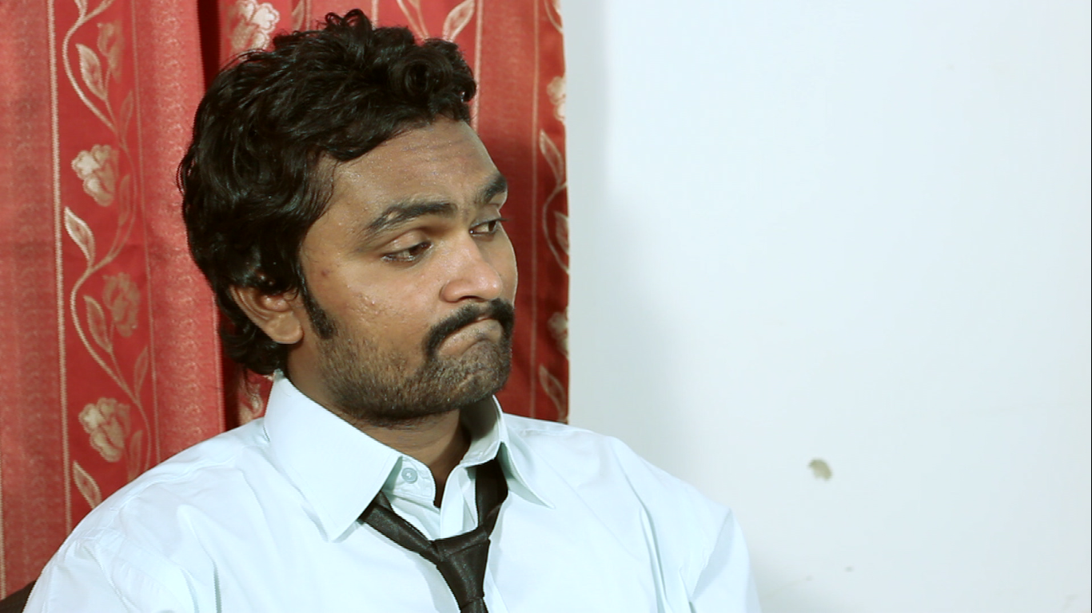
Video: Family Affairs
Notes:
The film can be found online here: https://vimeo.com/154576424

Slide 56
Video
Questions:
What do you think about this story?
Do these things also happen in your country?

Slide 57
Conclusion Part 2: What have we Learned?
Good standards will have a positive impact on you and your organisation!
Good characteristics and behaviour for individuals
Organisational standards
Words followed by action prevent corruption!
The importance of good policies and procedures

Slide 58
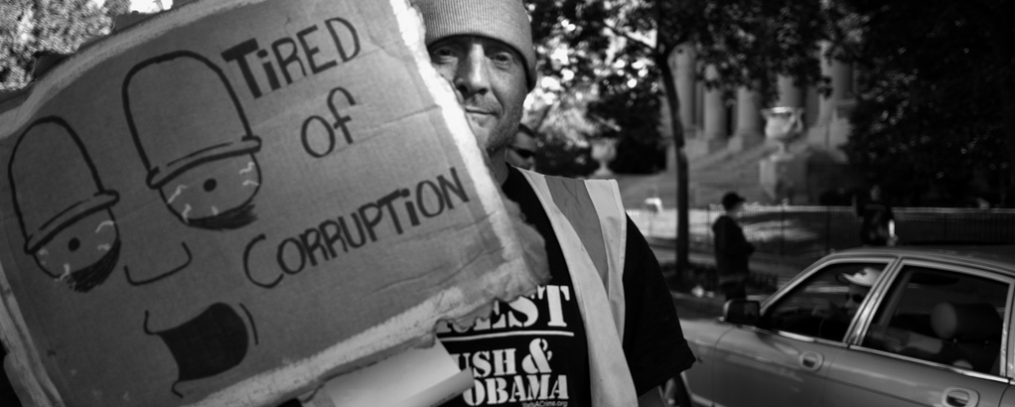
Part 3: You Can Fight Corruption

Slide 59
What we’ll Look at in Part 3
What can I do as an individual to stop corruption?
How can I work with others to fight against corruption?
What are the risks of fighting corruption?
“During times of universal deceit, telling the truth becomes a revolutionary act.” - George Orwell

Slide 60
AN HONEST PERSON WILL NOT
Close his eyes to corruption
Close his ears to complaints
Keep quiet about corruption

Slide 61
Victims: How can you fight it?
When you’re a victim of corruption, what can you do?
Give as many suggestions as possible for how ordinary people can fight corruption.
“The silence of the good people is more dangerous than the brutality of the bad people” - Martin Luther King Jr.

Slide 62
Share your Story!
There are many websites where people share their experiences with corruption. Is there a website in your country you can visit and share your story?
Social media can be a good way to share your story and raise awareness about how corruption hurts you and others.

Slide 63
A true Case from India: What do you think?
I did not pay Rs. 1000 + Rs. 500 to the Police
Passport | Police Verification for Passport
Reported on June 17, 2014
As you all might know the police need to verify your address when you apply for a passport. It is common practice that the police officers responsible for completing verification ask you to cough up some money, otherwise they might send a late or negative report about your address.
I was asked to pay Rs. 1000 at the Thana and Rs. 500 to the CID Inspector to complete my verification. I was scared of getting a negative report, but didn't want to pay the bribe either. So I called the police department and explained the situation to them. I was strictly asked NOT to pay any money. After they inquired with the local DSP, my verification process was successfully completed.
I got a clear report on the verification. I DID NOT PAY A BRIBE.
Please, let us all come together. I know you may feel afraid in the beginning, but there are good people in the Police Department. Get some help, and live like an honest citizen.

Slide 64
Personal Actions
Refuse to pay/accept a bribe
Use my voice
Ask for receipts
Contact supervisor
Discuss with colleagues
Take pictures/videos
Write down name and number
Report corruption to the police

Slide 65
Pledge
Make sure you are not to be a part of the problem, make a private pledge!
I pledge to…
be a responsible and honest citizen and
neither pay nor take bribes;
obey the law and encourage others around me to obey the law and to treat resources respectfully;
neither abuse any money entrusted to my care, nor any position I hold
act with integrity in all my dealings
always remember that public resources are intended for the benefit of the public, not for private gain.

Slide 66
Anti-Corruption Code of Conduct
An anti-corruption code of conduct can tell you what your responsibilities are, like:
Respect for the law
Refusing to give or take bribes
Safe ways to report corruption
Not using the organisation’s resources for private purposes
“The right thing to do and the hard thing to do are usually the same.” - Steve Maraboli

Slide 67
Sample Anti-Corruption Code of Conduct
We will avoid any conflict, real or potential, between our personal interests and the interests of our organisation
We will not give or accept bribery in any form
We will not for private purposes seek to influence any person or body by using our official position or by using force or threats.
We will not use deception, trickery or breach of confidence to gain an unfair or dishonest advantage
We will not misappropriate or otherwise divert property or funds entrusted to us
We will not give, solicit or receive directly or indirectly any gift or other favor that may influence the exercise of our function, performance of duty or judgement. This does not include conventional hospitality or minor gifts.
We will not favor friends, family or other close personal relations in recruitment, procurement, aid delivery, consular services or other situations.
We will report any evidence or suspicion of breach of this Code of Conduct

Slide 68
Whistle Blowing
When you are an employee and you suspect corruption in the company you work in, you may decide to act in order to stop future mismanagement practices. These people are called whistle blowers.
Remember:
Whistle blowing is about mismanagement, corruption etc. It is not a complaint system
Whistle blowing is a key instrument against corruption, BUT in many countries and organisations, there are no clear rules for whistle blowers. A whistle blower may carry high personal risk.

Slide 69
Whistle Blowing
It is crucial that the organisation has a safe whistle blowing procedure in place such as:
Tell the superior
Tell the board
Use the whistle blower channel if it exists
Remember:
Do it anonymously if it is too risky to reveal the whistle blower’s identity

Slide 70
How can I get others involved in the fight against corruption?
“Individually, we are one drop. Together we are an ocean.” - Ryunosuke Satoro

Slide 71
How Can I Work With Others?
Getting started
Coordinate with the anti-corruption organisations already in your country or internationally.
The following slides are inspired by Transparency International. Their toolkit has many helpful suggestions and instructions
Consider the National Context. Before you start, make sure that your group’s activities are legal. Check which permits you need to act as a group. In some countries it is also important to consider the safety of the activity you want to organise.

Slide 72
How Can I Work With Others?
Risks: It is important to undertake a risk assessment before starting certain activities. Check the following:
Permission: Before taking action, find out if your plans are not against the law. If you aren’t sure, talk to a legal expert.
Physical safety: Cooperate with officials, police and others to make sure that participants will be safe.
Privacy and anonymity: When making use of social media or other technology realise that there is a risk; anonymity cannot be guaranteed.

Slide 73
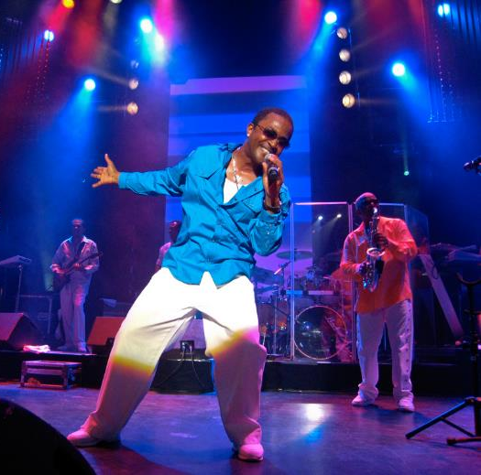
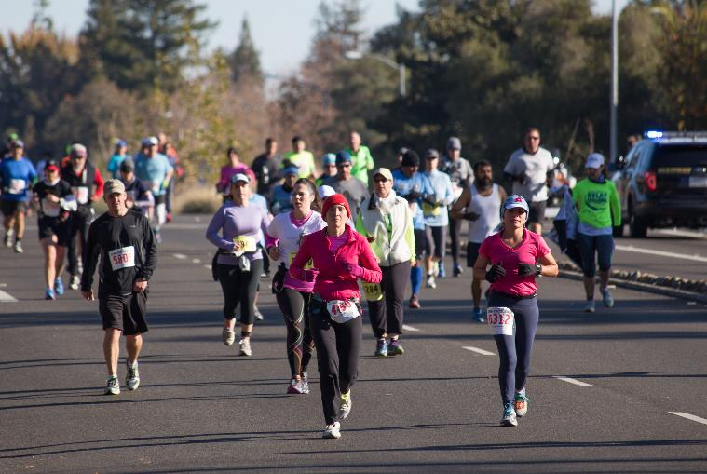
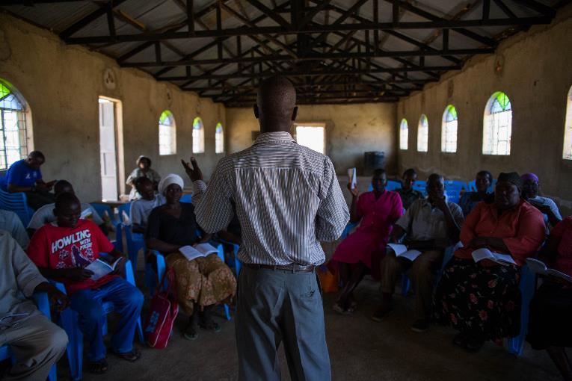
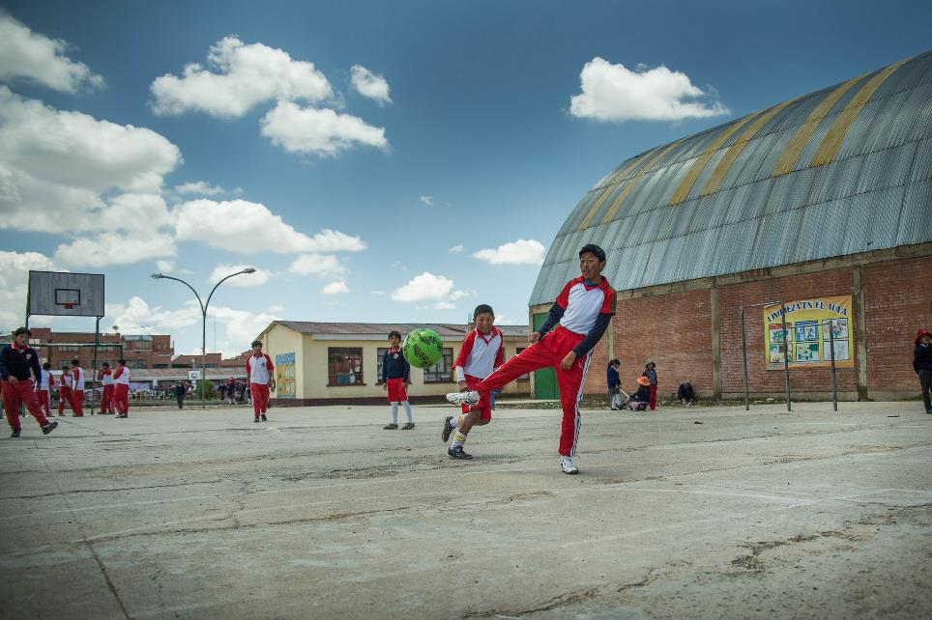
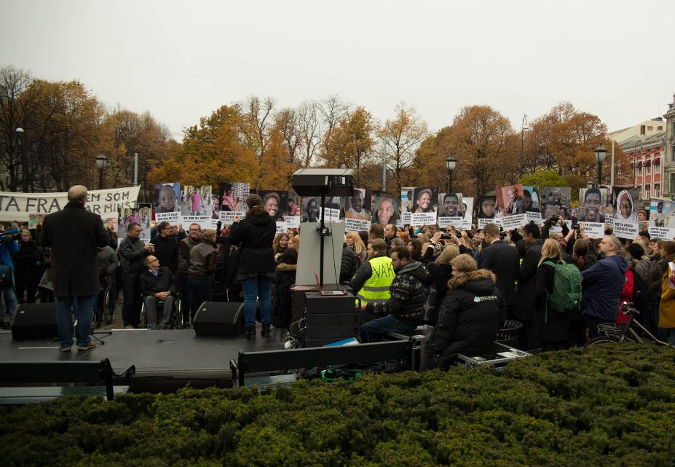
Get your Community Involved!

Slide 74
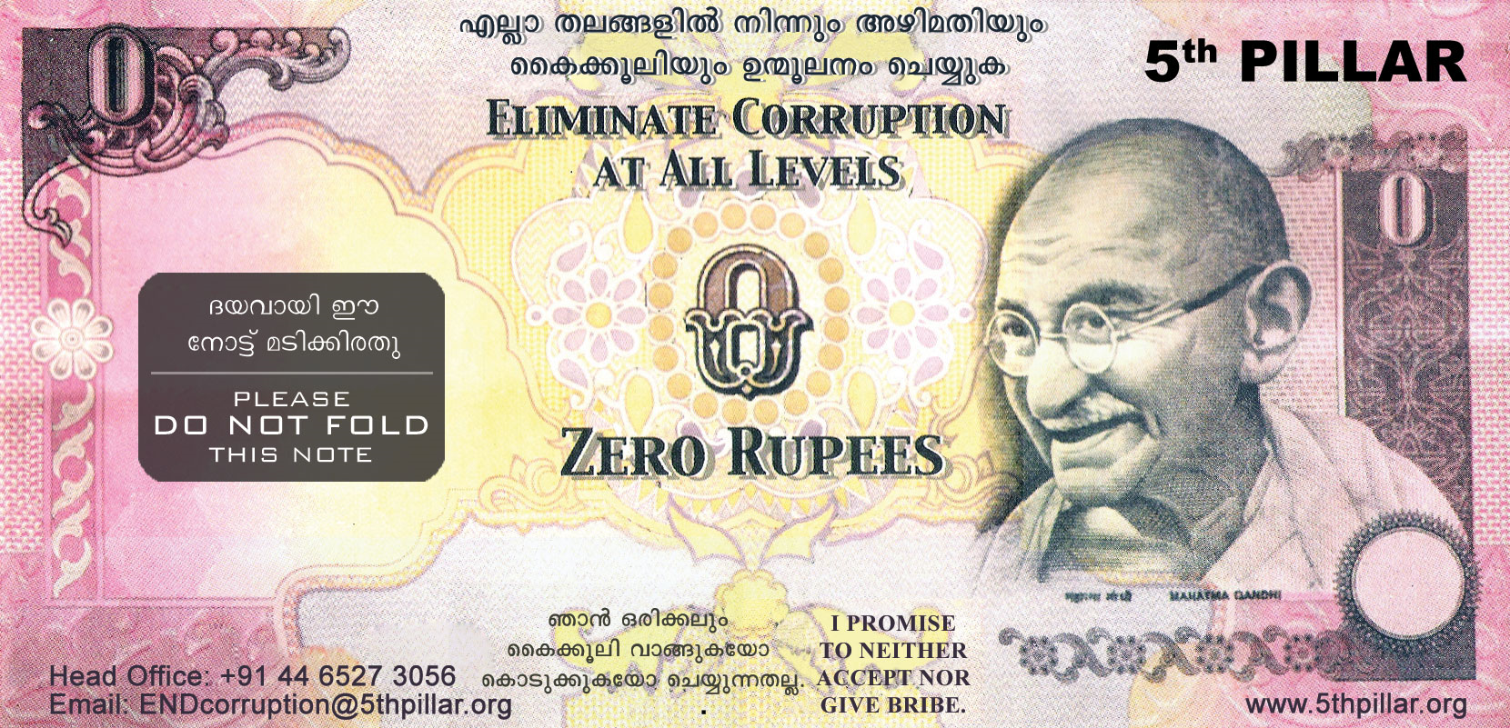
Zero Campaign
Become a Zero Hero Campaign (India)

Slide 75
Education and Awareness Raising
Conduct research and publicize
Design a special anti-corruption course (you can use this course as a guideline!) and include it within the school syllabus. Perhaps this can even be done at a national level in your country.
Organise seminars, meetings, workshops and courses targeting specific groups in society:
NGOs and other civil society organisations
Schools
Local community leaders
Companies
Religious leaders
Government departments

Slide 76
Media & Publications
Send your ideas and stories to a local, national or international newspaper
Opinion pieces
Interviews & articles
advertisements
Publish a magazine / leaflets
Use comics and cartoons (idea of Transparency International)
Create visual and audio media, like movies & songs
Use TV and radio (for example when you’re organising events)
Talk to others through social media!

Slide 77
Conclusion Part 3: What have we Learned?
Your voice and actions can make a real difference!
Share your story!
Act with integrity.
Make a pledge.
By working with others you can have a powerful impact!
Take the right steps to get started
Consider the risks
Get your community involved
Educate and raise awareness

Slide 78
Part 4: Corruption & Leadership

Slide 79
How can Leaders Prevent Corruption?
What we’ll look at in Part 4:
What can you as a leader do to prevent corruption?
Why is transparency so important?
What tools are good for preventing or removing corruption?
What kind of policies and procedures are important for preventing corruption?
What policies and procedures can be used to sanction corruption if it’s found?

Slide 80
Inspirational Quotes on Leadership
“It is not only for what we do that we are held responsible, but also for what we do not do.”
- Molière
“As a leader it’s a major responsibility on your shoulders to practice the behavior you want others to follow.”
- Himanshu Bhatia
“Nothing will work unless you do.”
- Maya Angelou
“There is a moral obligation, I think, not to ally oneself with power against the powerless.”
- Chinua Achebe

Slide 81
What can effective leaders do to avoid or fight corruption in their organisation, community, company or other places?

Slide 82
What can you as a leader do?
Make policies and procedures
Be transparent
Implement the policies and procedures

Slide 83
Step 1: Developing Policies and Procedures
Work out what policies you need:
Do your research. What do similar organisations have?
What's unique to your organisation?
What are the priorities?
Consult with people from across your organisation to get their ideas and comments

Slide 84
Step 2: Draft, Refine and Write your Policies
Write the policy in words that are easy to understand
Ask the “what if” question. Does it cover all the usual and unusual?
Talk to the people who will be enforcing policy, but also to those who have to live according to the policies.
Test the policy by asking for the opinion of others

Slide 85
Step 3: Approve and Endorse Policies
An attorney should check the wording and make sure it is according to national law.
The board of the organisation should endorse the policies.
There should be a procedure to publicise the policies in such a way that all stakeholders have access to it.

Slide 86
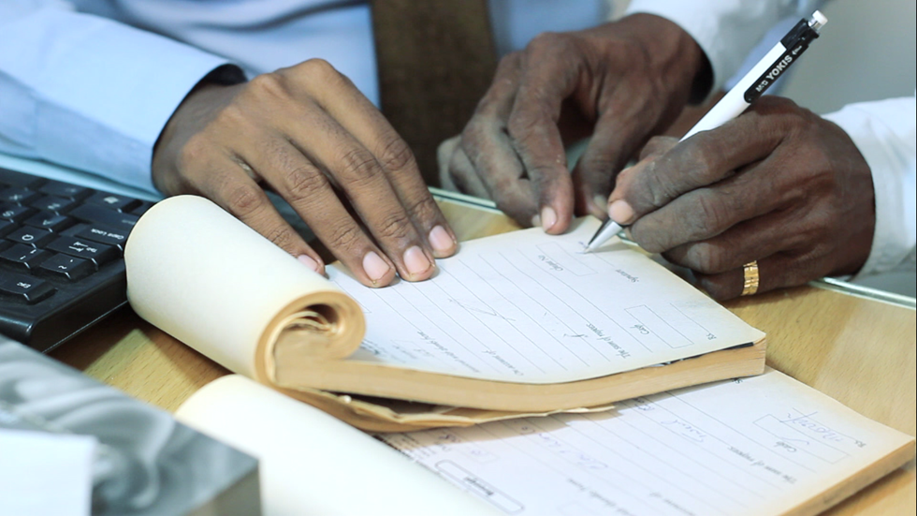
Video: Office Fraud
Notes:
The film can be found online here: https://vimeo.com/154574627

Slide 87
Video
Exercise
What policies and procedures were already in place in this organisation?
What policies and procedures are missing or not working?
Write those missing policies and procedures considering the earlier slides

Slide 88
Case Study
The board and leadership of a mid-size NGO has been working on designing and writing policies and procedures for their organisation. They have given everybody in the organisation a copy of these policies and procedures, but they have observed that many of these rules are not known by their personnel or are simply ignored.
Question:
What can they do to make sure that the new guidelines are known and followed by everybody in the organisation?

Slide 89
Step 4: Approve and Endorse Policies
Be a personal example by strictly following the rules
Develop a training program that all staff and volunteers have to participate in
At the end of any training or information session, ask participants to complete a short quiz to show they have understood the information
Create posters or process charts to post around the workplace to keep key messages firmly in mind
Regularly promote a policy or procedure in internal newsletters or at team meetings.

Slide 90
Step 5: Review and Refine your Policies Regularly
Society, people and organisations constantly change. Make sure to set an expiry date for your policies and action plans, so that your policies remain relevant to your own organisation’s objectives, and remain in line with national law.

Slide 91
Policy Example
Conflict of interest
A staff member should avoid putting himself/herself in a position that may lead to an actual or perceived conflict of interest with the organisation.
A staff member confronted with conflict of interest should report this to his/her supervisor; he or she should have no authority in the final decision making related to the area of conflict of interest.

Slide 92
Policy Examples
Active and passive bribery
It is not permitted to solicit or accept any advantage in connection with work without permission of the employer.
Entertainment
Staff must not accept lavish or frequent entertainment from people with whom the organisation has official dealings, so that they will not be placed in a position of obligation to the gift giver.
Property of the organisation
Staff who have permission to use organisation’s property should ensure that it is only used for the organisation’s business. Using the organisation’s property for personal use or resale is forbidden.

Slide 93
Staff Policy
Clear policies and procedures for the staff are essential. When you don’t have clear rules, you can’t expect people to follow them.
Example of items included in a Staff Policy Document
Behavior & Personal Conduct
Use of equipment: keys, computer, phone, email & internet
Safety and security
Confidentiality
Employee & employer rights
Sanctions in case of violation

Slide 94
Case Study
You are responsible for all purchases in a large company. You have to buy 5 new Toyota Hiace vans. You ask three car dealers for their best offers. One of these dealers is a good friend of yours and he offers you free maintenance for your private car if you accept his offer. You accept this offer and he sells the vans to the company.
Questions:
What do you think about this deal?
Can you suggest a policy and/or a procedure that deals with these issues?

Slide 95
Purchasing Policy Example
Purchasing
A committee should be formed and made responsible for the organisation’s purchases.
The purchasing committee will define a purchasing protocol to ensure consistency, lawfulness and transparency of all purchases.
The committee will monitor procedures to determine whether or not the protocol is respected.

Slide 96
Transparency
Definitions of transparency
Operating in such a way that it is easy for others to see what actions are performed
A fundamental philosophy of total openness between individuals and organizations.
Able to be seen through; easy to notice or understand; honest and open, not secretive

Slide 97
Transparency
As a principle, public officials, civil servants and those in leadership positions in an organisation have a duty to act visibly, predictably and understandably.
Simply making information available is not enough to achieve transparency. Large amounts of raw information in the public domain may be unclear/confusing rather than transparent.

Slide 98
Transparency
Information should be managed and published so that it is:
Relevant and accessible, given in plain and understandable language. Information should be easy to understand for everyone.
Timely and accurate: Stakeholders should have enough time to read and give feedback before publishing. Information should be up-to-date, correct, and complete.

Slide 99
Transparency in Finances
Examples of financial policies and procedures
Separation of duties, appointing specific persons who can sign checks and carry out bank transfers
Appointing and limiting persons who can approve bills and invoices to qualified personnel
Having a bookkeeping system and cash book with data that cannot be altered after entered
Having an external accountant that regularly monitors and verifies the organisation’s bookkeeping
An external annual audit of the organisation’s finances is done by a nationally registered and approved auditor.

Slide 100
Transparency in Reporting
Reporting according to mutually agreed upon procedures, such as monthly, quarterly and annual narrative and financial reports to donors and stakeholders
Based on:
Project application, logframe/RBM (Result based management) and budget, approved by the organisation responsible
Timelines and activity sheets
Up-to-date pictures and stories from the implemented projects
Note: Reporting should include success and failure, real figures, success and problems. Don’t hide things.

Slide 101
Transparency through Monitoring and Evaluation
Internal and external monitoring and evaluation
Internal monitoring mechanisms
Regular inspections of stock and of the work place
External inspections
External project/program evaluation for larger projects
In some large organisations an internal auditor has the task to make sure that:
The financial procedures sound and applied
The policies and procedure respected
The organisation works efficiently, effectively and economically

Slide 102
What can you do as a director or a board member when you suspect corruption in your organisation?

Slide 103
Suspected Corruption
Internal actions
Inform the board, but make sure to keep this confidential so that the evidence such as administration and bookkeeping cannot be changed, hidden or destroyed, nor the reputation of one or more employees be damaged.
Confront the individual privately, so that he or she has an opportunity to explain him or herself.
Conduct a thorough internal investigation.
When evidence is found apply the appropriate sanctions. See slides about “Sanctions”.

Slide 104
Suspected Corruption
External actions
If there is enough evidence from an internal investigation of widespread corruption, execute an external investigation or audit.
If the corruption relates to a funded project you inform the donor about the problem and the actions you have taken. Never try to hide this from the donor.

Slide 105
Sanctions
Principle:
Policies and procedures must be kept. When people ignore or violate policies there should be consequences. Without sanctions, people who keep rules will feel betrayed.

Slide 106
Risks and Sanctions - Individual
MODERATE
SEVERE
Warning issued
Temporary suspension of employment
Temporary reduction of benefits
Reduction of pay
Public apology
Termination of employment
Membership dismissal
Possible fines or prison sentence
Damages compensated for/paid by the responsible party

Slide 107
Sanction Examples
False whistle blowing
Reduction of benefits/pay + Public apology
Embezzlement
Immediate dismissal + external audit

Slide 108
Risks and Sanctions - Organisation
Investigation: A donor or an organisation’s supporters might demand an external audit. Pressure can be put on legal authorities of your country to look into the matter.
Total reimbursement: Your organisation may have to pay back any money donated if corruption is found. This can also include legal and audit fees during an investigation.
Prosecution: If the corruption is serious enough, you, or members of your organisation could lose your license, job, or go to prison
Always operate under the assumption that there will be zero tolerance for corruption. It is better to be safe than sorry!

Slide 109
Code of Conduct
When creating a practical and workable anti-corruption policy, the key document involved is an anti-corruption code of conduct. The sample from Danida (Danish government) below is an example of this type of document.

Slide 110
Sample Anti-Corruption Code of Conduct
We will avoid any conflict, real or potential, between our personal interests and the interests of our organisation
We will not give or accept bribery in any form
We will not for private purposes seek to influence any person or body by using our official position or by using force or threats.
We will not use deception, trickery or breach of confidence to gain an unfair or dishonest advantage
We will not misappropriate or otherwise divert property or funds entrusted to us
We will not give, solicit or receive directly or indirectly any gift or other favor that may influence the exercise of our function, performance of duty or judgement. This does not include conventional hospitality or minor gifts.
We will not favor friends, family or other close personal relations in recruitment, procurement, aid delivery, consular services or other situations.
We will report any evidence or suspicion of breach of this Code of Conduct

Slide 111
Conclusion Part 4: What have we Learned?
As a leader, you have the power and responsibility to create a culture of anti-corruption! Lead by example:
Be a person of integrity, responsible, transparent & accountable
Good tools will empower you and others to stop corruption in its tracks!
Creation and enforcement of policy & procedures
Sanctioning
Code of Conduct & Action Plan

Slide 112
Course Conclusion
“You must be the change you wish to see in the world” - Mahatma Gandhi
However you aren’t alone! Corruption can be fought by working together. Please share what you learned in this course to make the world a better, safer place!

Slide 113
Image Credits
Slide 1: Kåre Eriksen, Digni
Slide 2: Kaysha on Flickr under CC BY-NC-ND 2.0-licence.
Slide 3: Sigbjørn Kiserud, Digni.
Slide 4: Futureatlas.com on Flickr under CC BY 2.0-licence.
Slide 10: Elizabeth Laura Walmann, Digni.
Slide 43: Kåre Eriksen, Digni.
Slide 58: Devin Smith on Flickr under CC BY 2.0-licence.
Slide 60: Screenshot of font Apple Color Emoji
Slide 74: Zero campaign from www.5thpillar.org
Slide 73, first row from left: Anirudh Koul on Flickr under CC BY-NC 2.0-licence, David Yu on Flickr under CC BY-NC-ND 2.0-licence, Robert Couse-Baker on Flickr under CC BY 2.0-licence and Sigbjørn Kiserud (Digni).
Slide 73, second row from left: Sigbjørn Kiserud (Digni) and Erik (HASH) Hersman on Flickr under CC BY 2.0-licence -licence and Sigbjørn Kiserud (Digni).
Slide 78: Sigbjørn Kiserud, Digni.

Slide 114
Source Credits
Slides 2, 35, 71, 72, 75, 76, 95: Source or inspired by Transparency International.
Slide 19 Grand corruption: Development Education.ie, “Definition”.Online. http://www.developmenteducation.ie/resources/glossary/. Accessed 16 September 2011.
Petty corruption: Oracle ThinkQuest: Education Foundation, “Definition”. Online. http://library.thinkquest.org/05aug/00282/other_glossary.htm. Accessed 16 September 2011.
Slide 23:source: http://finance.uark.edu/PDFS/RedFlagsFraud.pdf
Slide 31, 32, 34, 35 source: http://www.schools.utah.gov/finance/Professional-Development/UFOMA/2a—UFOMA---Fraud-Triangle.aspx
Slide 65: source: http://ipaidabribe.gy
Slide 63: Pledge: INSPIRED BY: CORRUPTIONWATCH.ORG.ZA
Slide 67 and 110: Code of Conduct:
http://uganda.um.dk/en/~/media/Uganda/Documents/English%20site/AnticorruptionpolicyEnglishversion.pdf
Slide 74: Source: http://en.wikipedia.org/wiki/Zero_rupee_note
Slide 83 Inspired by: http://humanresources.about.com/
Slide 84: Inspired by: http://humanresources.about.com and http://www.volunteer.vic.gov.au/
Slide 89: Inspired by: http://www.volunteer.vic.gov.au/manage-your-volunteers/policies-and-procedures/implementing-policies-and-procedures
Slide 96: http://www.merriam-webster.com/dictionary/transparent
Slide 102 : Inspired by: http://www.forumsyd.org/PageFiles/1234/Guidelines%20-%20suspected%20corruption.pdf?epslanguage=sv

Slide 115
Kaadinchey la
ขอขอบคุณ
gracias
takk
مہربانی
བཀའ་དྲིན་ཆེ་
Thank you!
cảm ơn bạn
gɔ̀ɗí
សូមអរគុណអ្នក
merçi
ຂໍຂອບໃຈທ່ານ
رەھمەت
terima kasih
Asante
баярлалаа
谢谢

